Slide 1

How to Kinect - Programmieren mit Kinect V2
Sebastian Mansow-Model
Karen Otte

Slide 2
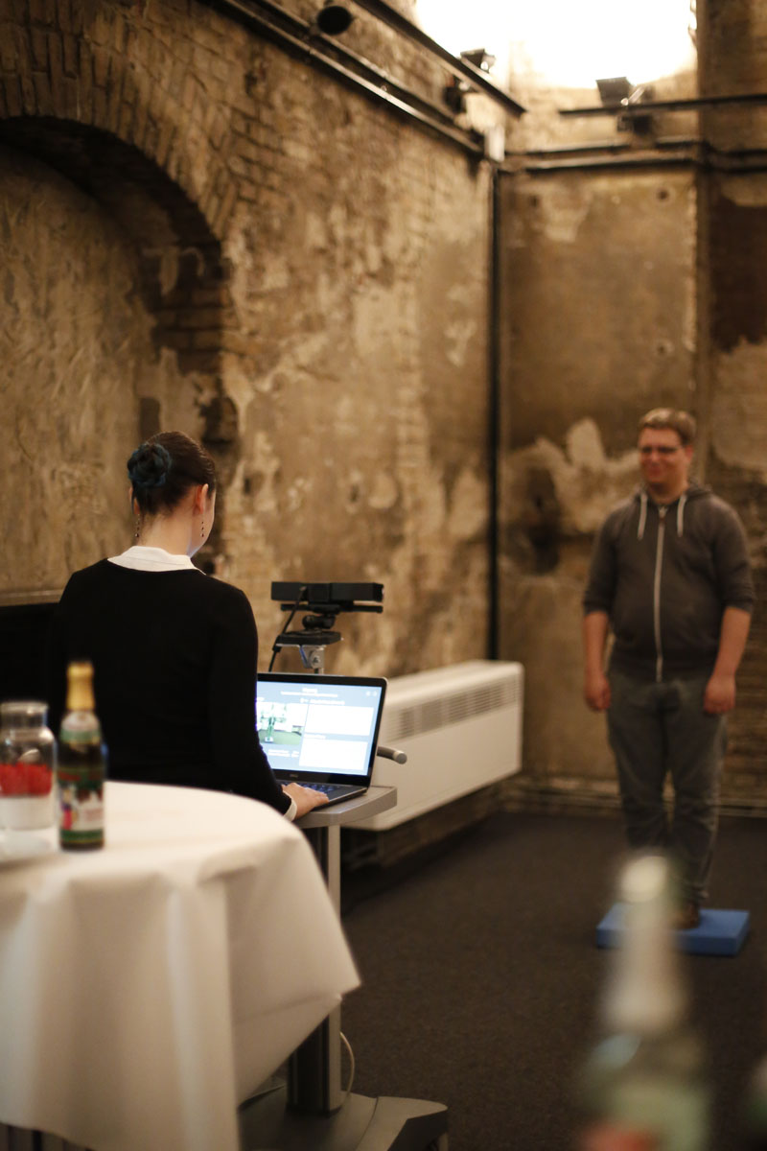
About us
Motognosis develops digital health systems for recognizing and analyzing motor dysfunction in people with neurologic conditions, utilizing affordable consumer sensors like the Microsoft Kinect V2.
Sebastian Mansow Model
Mathematician
Co-Founder
Karen Otte
Medical Computer Scientist
Software developer and Data scientist
https://github.com/KinectBerlinMeetup/Kinect101.git

Slide 3
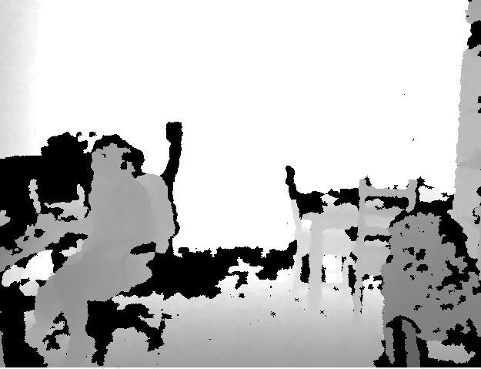
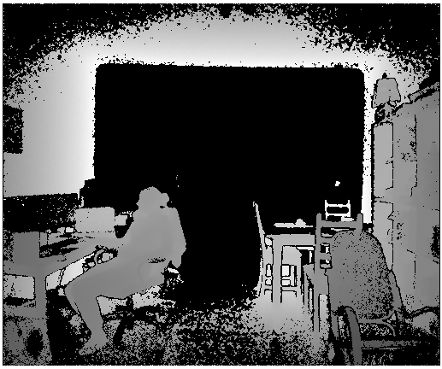
Kinect History
 | Kinect for Windows 1 | Kinect for Windows 2
Color Camera | 640 x 480 @30 fps | 1920 x 1080 @30 fps
Depth Camera | 320 x 240 | 512 x 424
Max Depth Distance | ~4.5 M | 8 M
Min Depth Distance | 40 cm in near mode | 50 cm
Depth Horizontal Field of View | 57 degrees | 70 degrees
Depth Vertical Field of View | 43 degrees | 60 degrees
Tilt Motor | yes | no
Skeleton Joints Defined | 20 joints | 25 joints
Full Skeletons Tracked | 2 | 6
USB Standard | 2.0 | 3.0

Slide 4
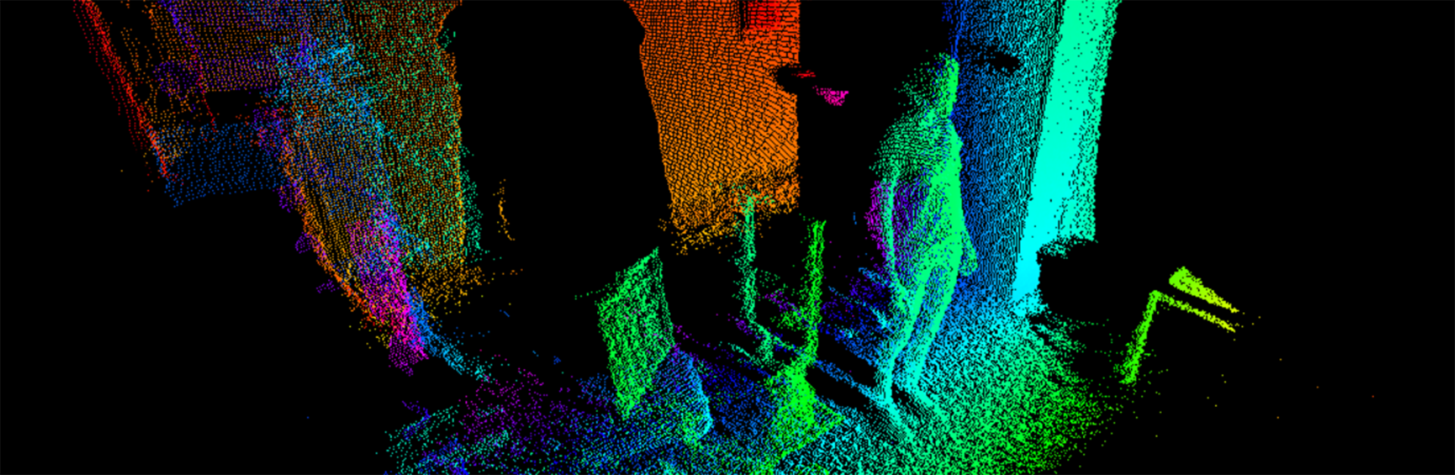
How it works – Demo Time!
Notes:
Kinect Evolution
RGB Video
Infrarot Video
Depth Video
Audio Beam
Studio
Point Cloud
Recording und wieder abspielen
HD Face Basics WPF (Gesicht zu klein gerendert???)
Kinect Fusion Explorer WPF … oder 3D Scan Store App
In exTremory

Slide 5
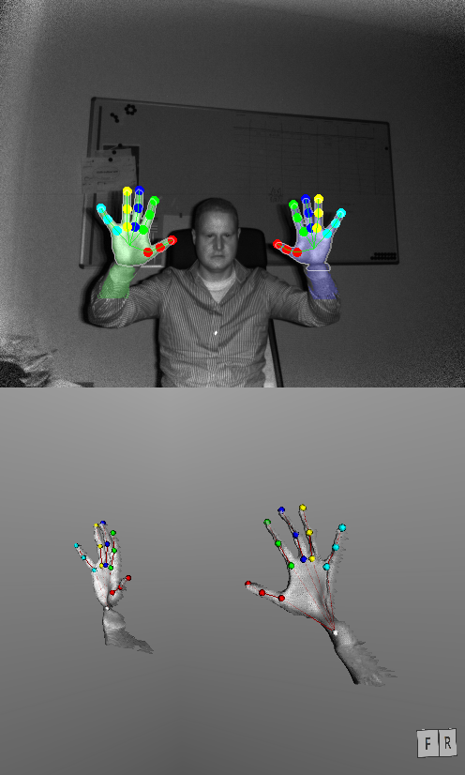
Capabilities
Im SDK:
Depth / IR
Audio
HD RGB
Face / HD Face
Skeleton
Gestures
UI Controls
3D Modell
Unity
C# / C++
Windows Store
Sonst:
Finger / Hand
Network
Multi-Kinect
Heartrate
Eyetracking
Python
JS / Node.js
Java
Processing
Linux / OS X

Slide 6
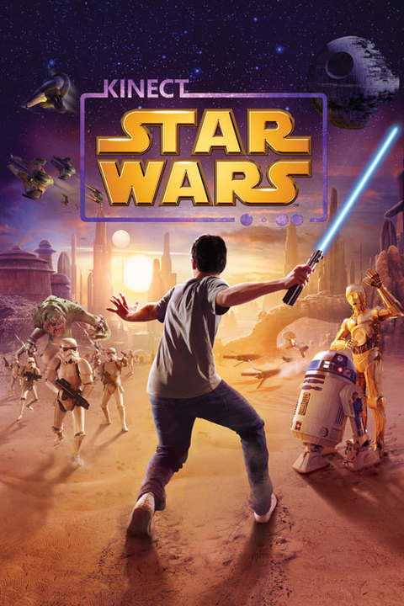
Games
V1: 130 games
V2: 20+ games
Themen:
Sports / fitness / dance
Interaction for children
Adventures
Voice commands (e.g. Skyrim)
As other optional feature

Slide 7
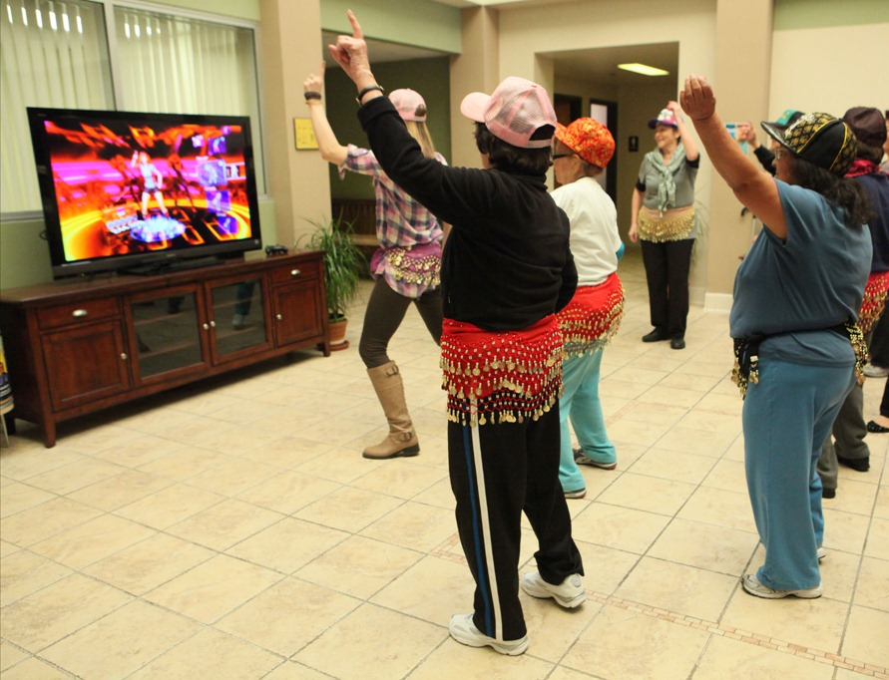
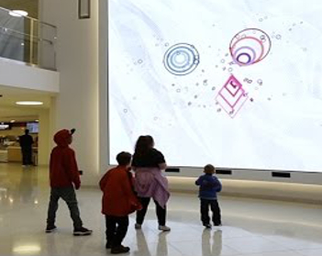
Serious Games
Physiotherapy / Reha
Cognitive training
Elderly people
Specialised therapy for children
Education

Slide 8
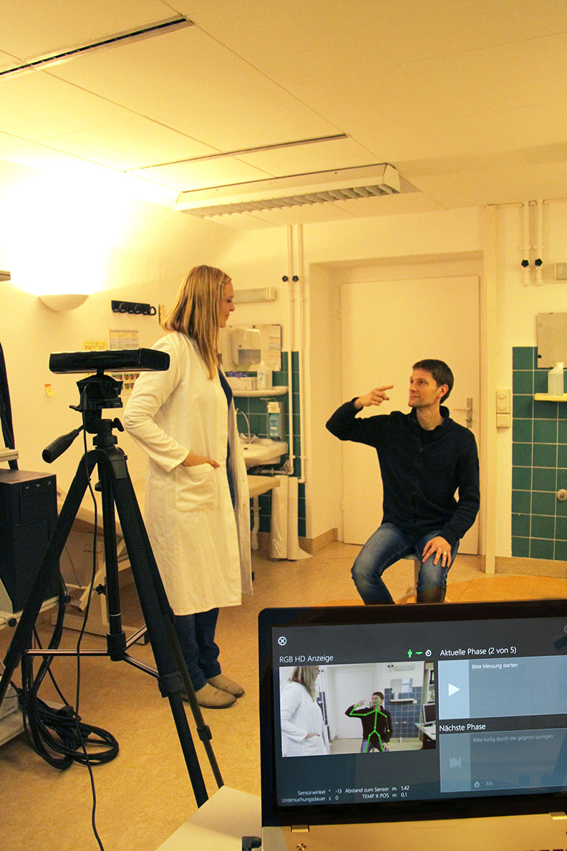
Medicine and Research
PubMed: 455+ papers
Movement analysis
Sit, stance, gait
Fall detection
Sleep analysis
Breathing
Movement, posture
Coordination
Pointing, grabbing
Avoiding obstacles
Scholar: 58,300 findings
Topics:
Robotics
3D modelling
NUI / HCI
Surveillance analysis
Motion tracking
Animal behaviour

Slide 9
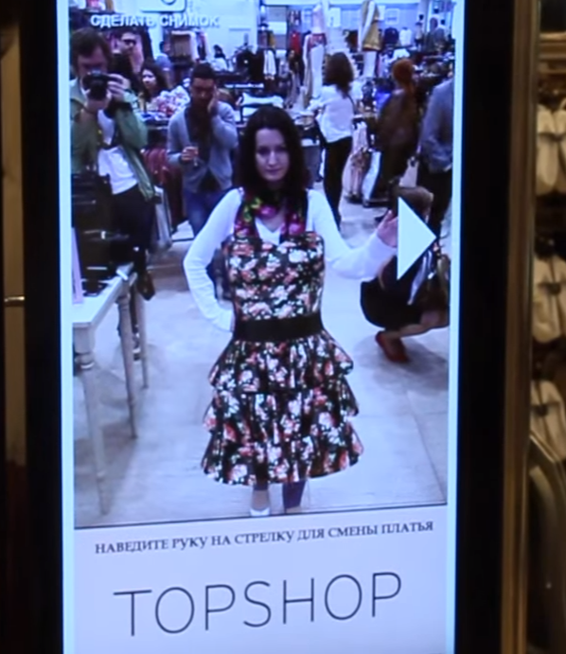
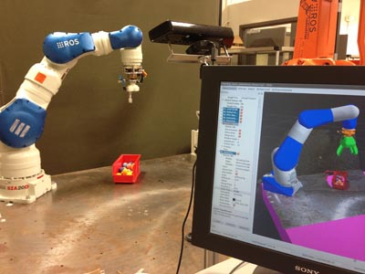
Industry and Business
Gesture control
Industrial control and safety
Motion capture (movie and games)
Customer analysis and marketing

Slide 10
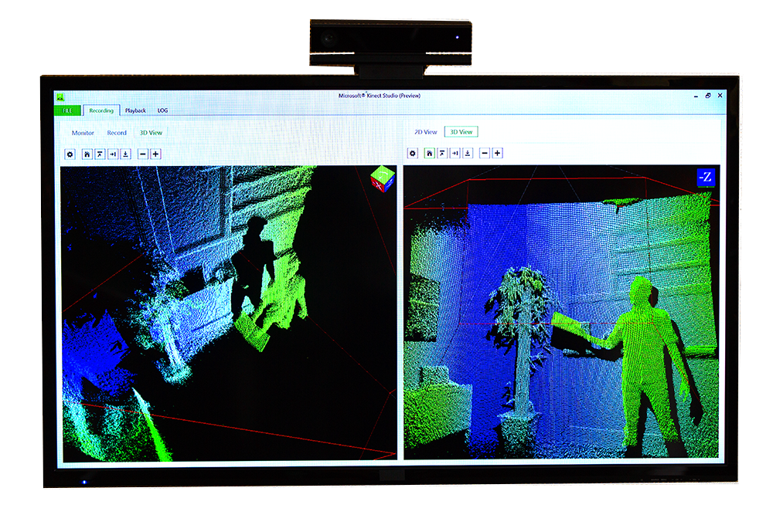
Helper and Tools
Automated Tests?
Kinect Studio API
My Wrapper (alpha...)
Reactive Kinect API
Official Tools (e.g. Speech Recognition)
Visual Gesture Builder

